Slide 1


Polarion ALM
16 June 2023

Slide 2

Polarion ALM
Polarion Application Lifecycle Management (ALM) is be used to create and maintain all requirements, risk files and test data for product development. This enables traceability between requirements, their corresponding product risks, and the testing required to document product design and development.
What is work item?
Work Items represent various artifacts - for example requirements, tasks, change requests. Each artifact type is represented in Polarion by a Work Item type defined in the global configuration, the project configuration, or both.
Each work item has multiple fields for user input, such as,
Author
Title
Description
Project
Approval status
Etc...
All the data referenced in the PRTM, FMEAs or Risk Assessments are stored in Work Items.

Slide 3
Document vs Report
 | Document | Report
Definition | Documents (or LiveDocs) are document-like containers for both free-form text and granular Work Items. (think MS Word) | Report Page (or LiveReport) are custom-built layouts for a report with charts that retrieve, aggregate, and/or format Work Item and other project data.
OOTB Redlining feature | Document has OOTB redlining feature. | LiveReports do not have OOTB redlining feature.
Traceability tables and data tables | Document do not support traceability matrices. | Report can be custom built to support traceability matrices
Use | All banner pages are configured using Documents. | All traceability matrices and data tables are custom built using LiveReports.

Slide 4
Process definition
User input
Polarion generated outputs
DHF deliverable as pdf export
Banner page
Codeless LiveDoc
(Polarion word editor)
LiveDoc or Document
Graphical user interface
(or)
Codeful
LiveReport or Report
Data as attachment
Import in bulk
(or)
Codeful report
(Polarion spreadsheet)

Slide 5
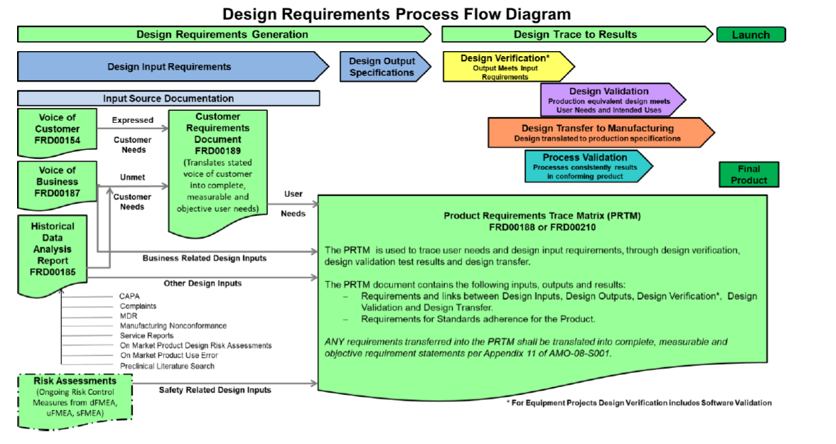
Surgical Vision deliverables mapped to Polarion Work Items
Surgical Vision deliverables mapped to Polarion Work Items
Verification Test Case
Validation Test Case
Design Output Specification
VOC
System Requirement
Design Transfer
VOB
User Need
HDA
System Requirement
Input Source
Key takeaway
The data model has a unique location for all Surgical Vision deliverables.
TCS Confidential

Slide 6
Surgical Vision deliverables mapped to Polarion Work Items
Voice of Customer
Is summarized by
Voice of Customer
Is derived by
User Need
Is validated by
Validation Test Case
Is derived by
Voice of Business
Is refined by
Is verified by
Is derived by
System Requirement
Verification Test Case
Historical Data Analysis
Is verified by
Is implemented / refined by
Risk Control
Subsystem Requirement
Is realized by
Is realized by
Design Output Specification
Key takeaway
The data model configured to match Surgical Vision processes and deliverables.

Slide 7
Creation of Banner page
Create
Create document using pre-configured templates
Edit the document
Save
Save the document
Export
Export pdf and redline version
Edit
The templates in the Polarion system are maintained current by the Polarion Project team.

Slide 8
Creation of report page
Import
Import legacy work items with links in bulk
Edit
Edit work items and links
Create
Create new work items and links
Export
Export pdf and redline version
Approve
Approve work items
The reports are configured and maintained by the Polarion Project team.
The approval process is a ‘nudge’ to minimize user errors.

Slide 9
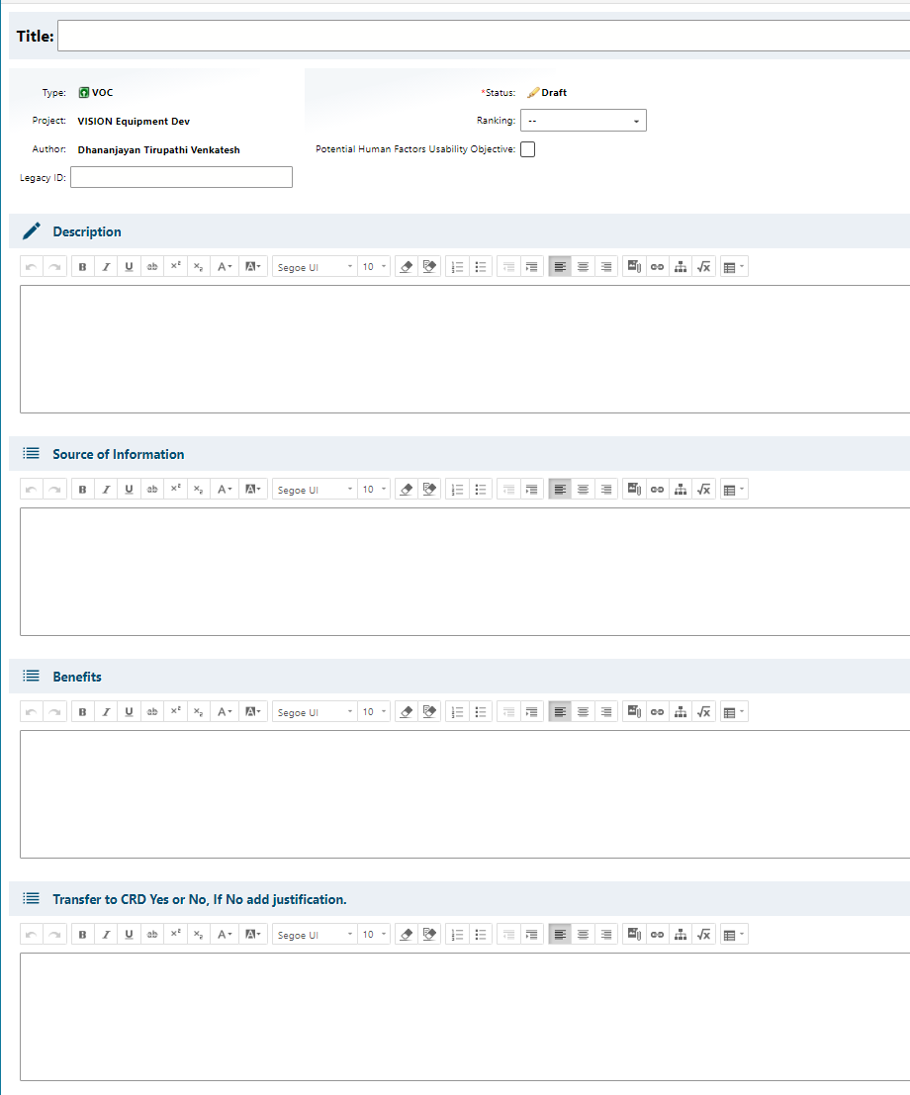
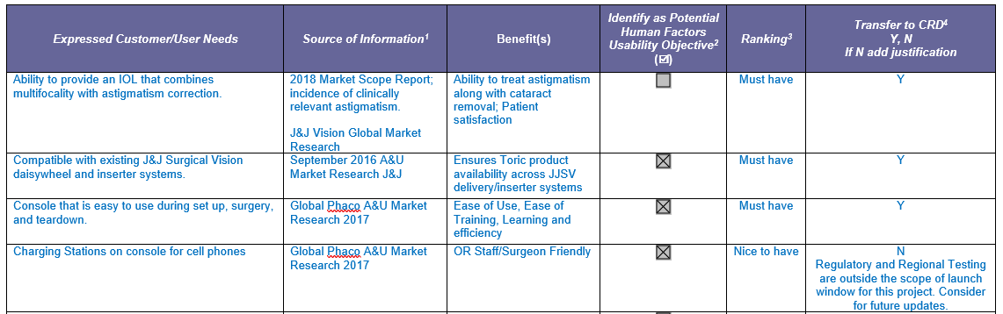
Work Item definition- Example VOC
User experience objectives
Give what they want.
User must not have to think.
Approach
Mimic the Surgical Vision process/templates as-is.
Polarion Screenshot
JJSV Template Screenshot

Slide 10
Creation of PRTM
Import / Create
VOB
Design Output Specification
Product Requirements Trace Matrix
VOC
System Requirement
Output
Subsystem Requirement
Validation protocol/plan/report
HDA
Verification protocol/plan/report

Slide 11


Polarion ALM
Universal Data Model
Team Collaboration
Universal Data model enables multiple RTMs and FMEAs implementation in a single template
Collaborate on shared assets easily and Securely
Control who can see what, who can change what, and when
Immediate Benefits and Value
Velocity Scripting
Provides the flexibility to customize the reports and match with existing templates
Configured Reports are replica of existing templates
Customizable header and footer of export PDFs
Capture and preserve the state of project at any point of time using Baselines
Compare baselines to check the difference between two revisions
Reuse or branch the data for effective sequential or parallel project
Traceability
Tracing between different artifacts is just a click away
FDA 21 CFR PART 11
Accurate traceability for all artifacts
Intuitive interface increasing end user acceptance and productivity
Real-time monitoring and reporting of defects
Test and Quality management
Achieve better quality and regulatory
compliance through end-to-end traceability and automated audit trails.

Slide 13
Polarion Work Items for JJSV Equipment pFMEA
Risk Record
Has risk record of
Has risk record of
Function
Hazard
Hazardous Situation
Cause of Failure
Failure Mode
Risk
Control
Harm
(Master)
NPD Projects
Master Project

